Slide 1
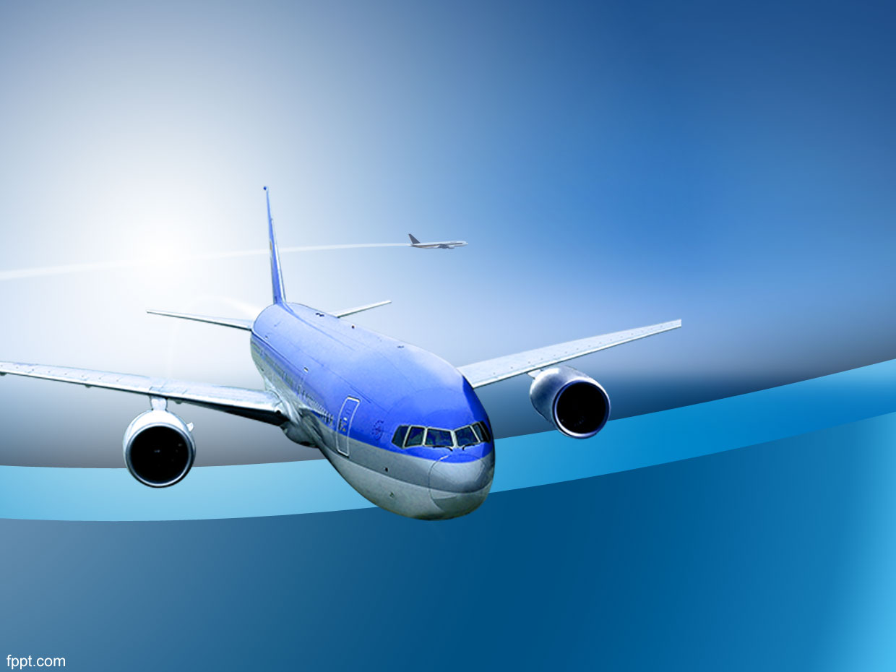

How Safe is Airlines?
By: Vinay Nagaraj

Slide 2
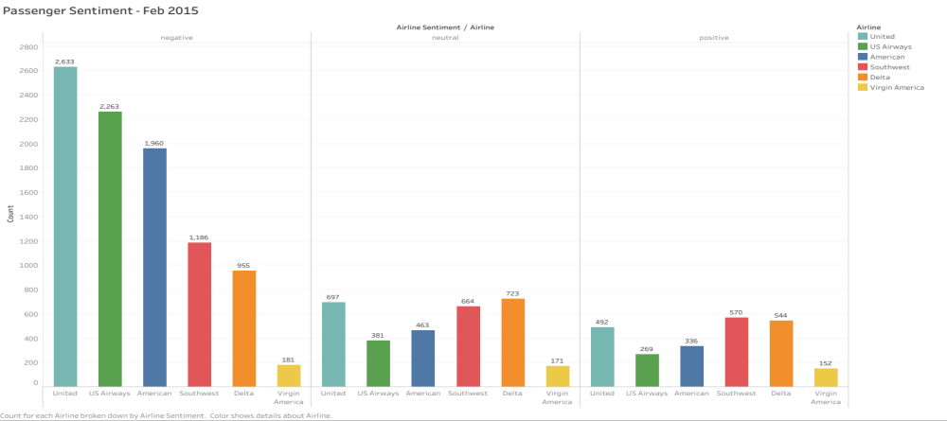
Passenger Sentiment – Feb 2015

Slide 3
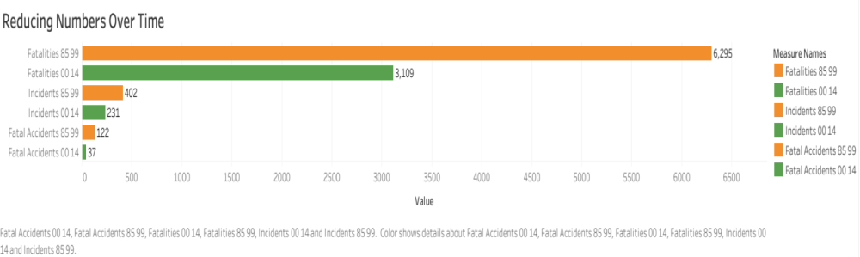
1985-99 vs 2000-14

Slide 4
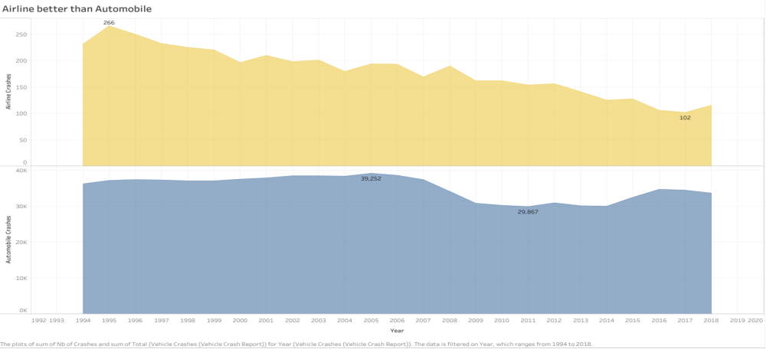
Airline vs Automobile

Slide 5
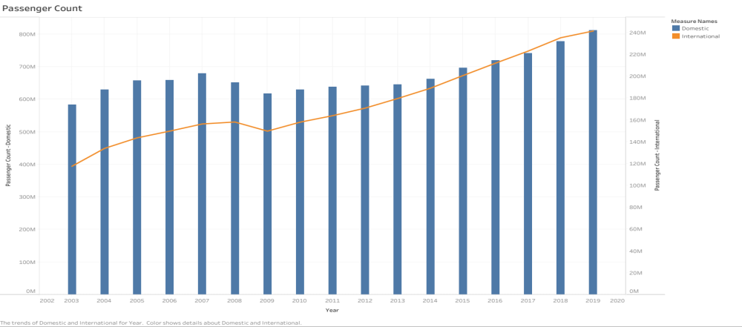
Passenger Count

Slide 6
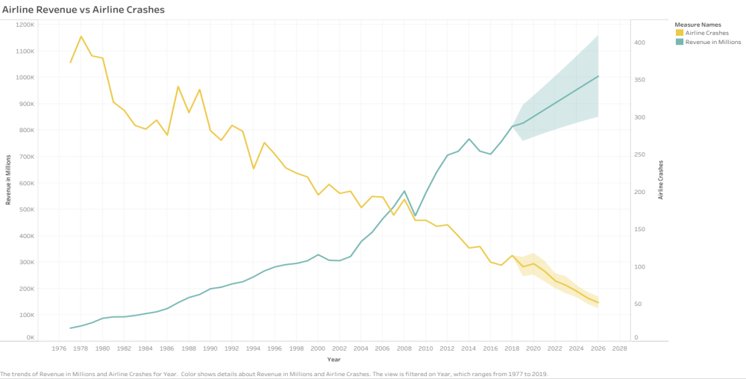
Revenue vs Crash

Slide 7
A Promise from us to you
Safe Travels !!

